Slide 1
Wearable IoT-Based Health Monitoring System
Continuous Heart Rate, Body Temperature, and Health Status Tracking
Project Overview
Continuous Tracking
A wearable IoT-based healthcare monitoring solution designed for continuous, real-time physiological tracking and centralized health status management.
Heart rate, body temperature, and other health parameters monitored without interruption.
Real-Time Platform
Health information delivered through a centralized monitoring platform accessible to caregivers.
Remote Intervention
Supports continuous remote health monitoring and timely healthcare intervention.
BOTTA BHARGAV VARA PRASAD
323129520041

Slide 2

Problem Statement
Continuous health monitoring is critical for early detection of medical conditions and timely healthcare intervention — yet current practice falls short.
Periodic Checkups
Missed Sudden Changes
Vulnerable Populations
Information Gap
Traditional health monitoring relies on scheduled medical visits and manual measurements, creating significant gaps in observation.
Without real-time health data, caregivers and clinicians lack the situational awareness needed to act promptly on deteriorating conditions.
Intermittent monitoring makes it difficult to identify rapid or unexpected shifts in a patient's health status before they escalate.
Patients, elderly individuals, and their healthcare providers require intelligent wearable systems capable of continuous, uninterrupted monitoring.
Periodic monitoring cannot substitute for continuous vital-sign surveillance in high-risk or elderly patient populations.

Slide 3




Proposed Solution
The Wearable IoT-Based Health Monitoring System addresses the limitations of periodic checkups through an integrated, always-on physiological data pipeline.
Wearable Sensors
IoT Transmission
Continuously collect heart rate, body temperature, and additional physiological parameters from the patient.
IoT communication modules securely transmit collected health data to a centralized monitoring platform in real time.
Centralized Platform
Remote Care
A secure, user-friendly interface displays live health information and triggers automated alerts on abnormal conditions.
Caregivers and healthcare professionals monitor patients remotely, enabling timely intervention without physical presence.

Slide 4
Project Objectives
The system is designed around ten clearly defined objectives spanning data acquisition, transmission, analysis, alerting, and patient outcomes.
1
Monitor Heart Rate
1
Detect Abnormal Conditions
Continuously measure and record the user's heart rate without interruption.
Analyze incoming data to identify readings that fall outside normal health thresholds.
2
Monitor Body Temperature
2
Generate Automated Alerts
Continuously measure and record body temperature as a key physiological indicator.
Notify caregivers or healthcare professionals immediately upon detection of anomalies.
3
Track Additional Parameters
3
Enable Remote Monitoring
Collect other relevant health parameters through wearable sensor integration.
Support continuous observation of patient health status from any location.
4
Collect Physiological Data
4
Support Timely Intervention
Acquire accurate, continuous data using wearable sensor hardware.
Provide the information infrastructure needed for prompt medical response.
5
Transmit in Real Time
5
Improve Patient Safety
Deliver health information to the monitoring platform with minimal latency.
Enhance overall health-status tracking and reduce risk through continuous awareness.

Slide 5

Wearable Sensors and System Components
Seven integrated components form the complete hardware and software architecture of the monitoring system.
Heart Rate Sensors
Temperature Sensors
Monitor the user's heart rate continuously, providing a primary vital-sign data stream.
Measure body temperature as a continuous physiological indicator integrated into the wearable device.
IoT Communication Modules
Cloud Connectivity
Transmit collected health information from the wearable device to the centralized monitoring platform.
Supports real-time transmission and centralized access to health data from any authorized location.
Centralized Monitoring Platform
Interactive Dashboard
Receives, stores, and monitors all incoming physiological information from connected wearable devices.
Displays live health parameters, historical trends, alert history, and current patient status in one interface.
All components operate in concert to deliver uninterrupted, end-to-end health monitoring from sensor to caregiver.

Slide 6
System Working Process
The system operates through an eleven-step end-to-end pipeline — from sensor attachment to historical data retention — ensuring no gap in physiological surveillance.
01
02
03
Sensor Attachment
Heart Rate Measurement
Temperature Measurement
Wearable sensors are attached to or integrated into the monitoring device on the patient.
Heart rate sensors continuously measure and record the user's cardiac activity.
Temperature sensors continuously measure body temperature in parallel with heart rate.
04
05
06
Additional Parameter Collection
IoT Data Processing
Data Transmission
Other wearable sensors collect supplementary health parameters as configured.
The collected physiological data is processed locally by the IoT system before transmission.
IoT communication modules transmit the processed data to the centralized monitoring platform.
07
08
09
Cloud Relay
Health Data Analysis
Anomaly Detection
Cloud connectivity enables real-time transmission and centralized access to health data.
The platform analyzes received health information against established normal thresholds.
When abnormal health conditions are detected, the system automatically generates an alert.
10
11
Alert Dispatch
Historical Retention
Alerts are sent to caregivers or healthcare professionals for timely attention and intervention.
All health information is maintained for historical monitoring, trend analysis, and clinical review.

Slide 7
Real-Time Health Monitoring Dashboard
The interactive dashboard serves as the primary interface for caregivers and healthcare professionals, consolidating all health data into a single, actionable view.
Information Displayed
Dashboard Capabilities
Live Heart Rate
Live Body Temperature
Continuous Monitoring
Remote Observation
Real-time cardiac readings updated continuously from the wearable sensor.
Current body temperature displayed alongside normal range thresholds.
Enables uninterrupted observation of all health parameters without manual intervention.
Caregivers can observe patient status from any authorized remote location.
Additional Health Parameters
Historical Trends
Time-series visualization of past health readings for pattern identification.
Change Identification
Historical Review
Other monitored physiological values presented in a unified view.
Facilitates rapid identification of shifts or deterioration in health parameters.
Supports clinical review of historical health information for informed decision-making.
Alert History & Patient Status
Log of all generated alerts and the current overall health status of the patient.
Timely Response
Provides the real-time awareness needed to respond promptly to abnormal conditions.

Slide 8
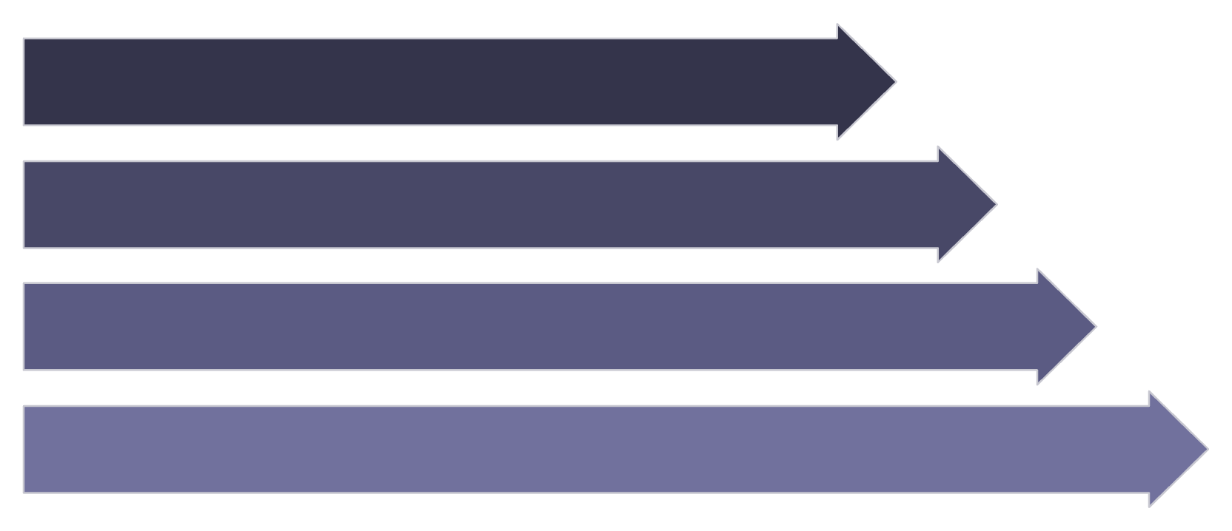
Abnormal Condition Detection and Alerts
The alert mechanism forms the safety backbone of the system, translating continuous data analysis into actionable notifications for healthcare professionals.
Alert Mechanism
Key Benefits
Continuous Monitoring
Improved Patient Safety
Early Detection
Continuous alerting reduces the window between an adverse event and clinical response.
Supports identification of health problems before they escalate to critical conditions.
Anomaly Analysis
Automated Alerts
Reduced Manual Dependence
Remote Healthcare Support
Eliminates reliance on periodic manual measurements for detecting health deterioration.
Enables delivery of healthcare services and oversight without requiring physical presence.
Caregiver Notification
Continuous Parameter Monitoring
Automated Alert Generation
Faster Awareness
All collected health parameters are monitored without interruption against defined thresholds.
When an abnormal condition is detected, an alert is generated and dispatched immediately to caregivers or healthcare professionals.
Caregivers gain immediate awareness of abnormal health conditions as they occur.
Alert History Retention
All alerts are logged and maintained for ongoing monitoring, clinical review, and audit purposes.

Slide 9
Applications and Scope
Target Applications
System Scope
The system is designed for deployment across a broad range of healthcare and wellness environments.
Wearable IoT-based monitoring supports continuous tracking of health parameters outside traditional periodic checkups, extending the reach of healthcare beyond clinical walls.
Hospitals
Continuous inpatient monitoring without requiring dedicated nursing observation at all times.
Secure
Scalable
Health data is transmitted and stored with security measures protecting patient privacy and data integrity.
The architecture supports expansion to additional patients, sensors, and monitoring parameters as needed.
Healthcare Centers
Outpatient and clinic-based monitoring for patients with chronic or recurring conditions.
Continuous
Remote-Ready
Elderly Care Facilities
Designed for uninterrupted, always-on monitoring rather than episodic or scheduled measurement.
Fully suited for remote health-status tracking across geographically distributed patient populations.
Continuous surveillance of elderly residents to detect health changes and prevent emergencies.
Fitness Applications
Health parameter tracking for fitness and wellness use cases beyond clinical settings.
Remote Patient Monitoring
Supports home-based and distributed patient monitoring systems for telehealth programs.

Slide 10
Conclusion
The Wearable IoT-Based Health Monitoring System represents a modern, integrated approach to continuous health surveillance — bridging the gap between periodic clinical visits and real-time physiological awareness.
Key Outcomes
Continuous Data Acquisition
Real-Time Transmission
Wearable sensors continuously collect heart rate, body temperature, and other physiological data without interruption.
IoT communication and cloud connectivity enable real-time delivery of health information to the centralized platform.
Patient Safety
Early Detection
Continuous monitoring reduces the risk of undetected health deterioration.
Supports identification of health problems before they reach critical severity.
Centralized Monitoring
Automated Alerting
Remote Healthcare
The monitoring platform provides live health parameters, historical trends, and a unified view of patient status.
Abnormal health conditions trigger immediate automated alerts to caregivers and healthcare professionals.
Enhances the reach and effectiveness of remote healthcare services.
"Wearable IoT-based continuous monitoring enables timely health awareness, remote monitoring, and faster response to abnormal health conditions."
Remote Healthcare Enablement
The system supports continuous remote monitoring, timely medical intervention, and improved patient safety.

